Slide 1
Providing Rapid Out of Hospital Acute Cardiovascular Treatment: PROACT-4
Embargoed Until 10:45 a.m. ET, Tuesday, Nov. 10, 2015
Justin A. Ezekowitz, Robert C. Welsh, Dale Weiss, Michael Chan, William Keeble, Fadi Khadour, Sanjay Sharma, Wayne Tymchak, Sunil Sookram, Neil Brass, Darren Knapp, Thomas I. Koshy, Yinggan Zheng, Paul W. Armstrong
on behalf of the PROACT-4 Investigators
20 November 2015
ClinicalTrials.gov NCT01634425

Slide 2
Funding / RWI
JE, RW, PWA online: www.vigour.ualberta.ca
DW and DK are employees of Alberta Health Services
TK is an employee of Alere Inc.
Direct PROACT-4 Funding provided by:
In-kind support received from:
Alere Inc (training and cartridges)
Alberta Health Services
Establishment funding for PROACT program:
Mazankowski Alberta Heart Institute, University Hospital Foundation
Trial Management (CVC): Tracy Temple, RN, Paula Priest, Courtney Gubbels
Statistics (CVC): Gray Zheng: Cindy Westerhout
Edmonton Paramedics, Paramedic Working groups, Patients

Slide 3
Background: Acute CV Disease
Patients with chest pain account for a major proportion of assessments in the emergency department (ED):
Many present via ambulance
++ investigations/$ to 'rule out’ acute CV disease
Most have a non-cardiac cause for their CP
5.5 million ED visits for CP annually in US¹²
Troponin is standard biomarker for assessing chest pain³
Cohort studies:
ER with hs-troponin NPV 99%⁴
Pre-hospital w/ troponin NPV ~100%⁵⁶⁷
RCT of pre-hospital point-of-care (POC) troponin testing (PROACT-3) did not show a difference in the primary outcome⁸
¹Kaul, CMAJ, 2007 ²Bhuiya, NCHS Data Brief. 2010 ³Thygesen EHJ 2012, ⁴Neumann, ESC 2015, ⁵Sørensen Am J Cardiol 2011, ⁶Roth Am J Cardiol 2001, ⁷Leshem-Rubinow Arch Intern Med 2011, ⁸Ezekowitz, CJC 2014

Slide 4
Objectives
In patients with chest pain presenting via ambulance, does measurement of POC-Troponin in the ambulance:
Primary
facilitate a shorter time from first medical contact to final patient disposition in the ED?
Secondary
a reduction in 30-day clinical events?

Slide 5
Trial Design
9-1-1 Call
Ambulance
Usual Care
Arrival on scene; Standard Care;
In/Exclusion;
Verbal Consent
R
Ambulance
ER
POC relayed to ER staff
POC-Troponin in ambulance
First medical contact
Patient disposition
Primary outcome:
time to disposition

Slide 6
Methods: Patients / Sample Size
Inclusion criteria
Exclusion criteria
PROACT-3: FMC-FD median 8.8 hrs (6.2-10.6 hrs)
Assumed:
90% power, two-sided alpha = 0.05
120 minutes (25% relative) reduction
283 patients per arm
10% device or sample failure, missing data, or protocol deviation
Total of 600 patients (300 patients per arm)
Patients activating pre-hospital EMS
Symptoms of acute chest discomfort for which acute CV disease is deemed to be the most probable diagnosis by EMS personnel
Age > 30 years
Patients with STEMI on ECG
Cardiac arrest
Patients with a diagnosis that is compatible with another disease e.g. trauma, asthma

Slide 7
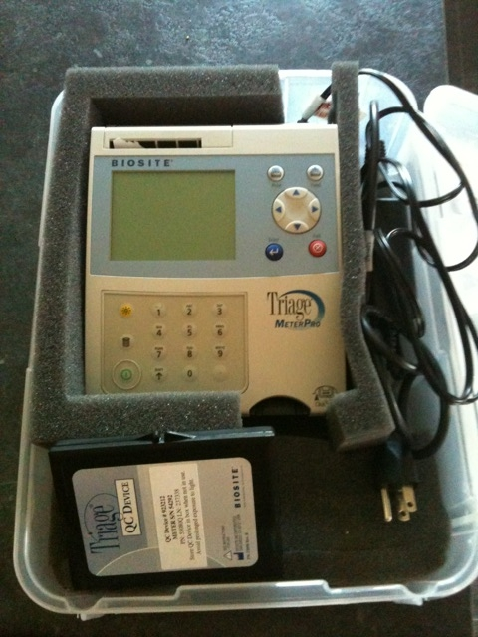
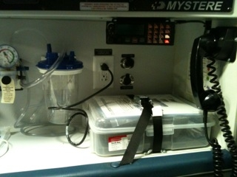
Methods: Troponin & Ambulances
POC device (Alere Inc, San Diego)
Cardio2 Troponin I
analytical sensitivity = 0.01 ng/mL
99th %ile = 0.02 ng/mL
assay & device Health Canada approved
result within ~15-18 minutes
Installed on ~25 ambulances
Edmonton: 3600 km^{2,} 1.1m people, 5 hospitals (2 PCI)
EMS System: >300 paramedics, 88 ambulances, ~4000 calls/yr for CP

Slide 8
Results
Assessed for eligibility
July 2013 –Feb 2015
Randomized (n=601)
Allocated to Usual Care (n=296)
Received POC-Troponin testing (n=2)
Allocated to POC-Troponin (n=305)
Received POC-Troponin testing (n=250)
Did not rec’v POC-Troponin testing (n= 55)
Loss to follow-up (n=0)
Withdrew consent* (n=2)
Loss to follow-up (n=0)
Withdrew consent* (n=2)
ITT Analysis (n=296) Per protocol analysis (n=294)
ITT Analysis (n=305) Per protocol analysis (n=250)

Slide 9
Baseline Characteristics
 | Usual care | POC-Troponin | p
n | 296 | 305
Age, years | 68 (53, 79) | 64 (53, 76) | 0.138
Female, n (%) | 45.9 | 41 | 0.220
Vital signs in ambulance
Heart rate, beats per minute | 80 (72, 94) | 82 (70, 98) | 0.466
SBP, mmHg | 153 (137, 172) | 147 (131, 169) | 0.054
Past medical history, %
Prior myocardial infarction | 27.7 | 31.5 | 0.311
Prior PCI | 16.2 | 10.2 | 0.028
Prior CABG | 7.8 | 9.5 | 0.449
Atrial fibrillation | 9.8 | 14.8 | 0.065
Diabetes | 24.3 | 26.2 | 0.591
Paramedics on scene, minutes | 27 (23 to 34) | 31 (26 to 38) | <0.001
Values are median (25-75%ile)

Slide 10
Troponin results
 | Usual care | POC-Troponin
n | 296 | 305
First troponin available, minutes | 138 (101-218) | 38 (28-55)*
POC-troponin I, ng/ml, n (%)
≤0.01 | - | 196 (64.3)
>0.01 | - | 53 (17.4)
>0.03 | - | 30 (9.8)
Not done/missing |  | 55 (18.4)
1st In-Hospital# troponin I, ng/ml, %
>0.1 | 9.5% | 14%
#In-hospital clinical troponin is the Beckman AccuTnI; *p<0.001
Notes:
Beckman AccuTnI assay (analytical sensitivity is 0.01 ng/mL with a 99th percentile [male and female] of 0.04 ng/mL).

Slide 11
Primary endpoint: ITT
 | Usual care | POC-Troponin | p | p adj*
N | 296 | 305
First medical contact to final disposition, hours | 9.14 (6.68, 11.17) | 8.85 (6.22, 10.76) | 0.069 | 0.074
Discharged from ED | 9.32 (7.37, 11.00) | 8.88 (6.65, 10.23) | 0.021 | 0.017
Admitted to hospital | 8.73 (5.43, 11.95) | 8.62 (5.25, 12.55) | 0.959 | 0.908
72.5% of all patients were discharged home. Adjustment by modified GRACE score (age, heart rate, systolic blood pressure, creatinine, cardiac arrest at admission, elevated cardiac enzymes, Killip class)

Slide 12
Primary endpoint: Per protocol
 | Usual care | POC-Troponin | p | p adj*
N | 294 | 250
First medical contact to final disposition, hours | 9.14 (6.69, 11.17) | 8.75 (6.20, 10.77) | 0.050 | 0.059
Discharged from ED | 9.32 (7.37, 10.98) | 8.87 (6.73, 10.57) | 0.035 | 0.034
Admitted to hospital | 8.73 (5.43, 11.95) | 8.17 (4.87, 12.25) | 0.621 | 0.535
72.5% of all patients were discharged home. Adjustment by modified GRACE score (age, heart rate, systolic blood pressure, creatinine, cardiac arrest at admission, elevated cardiac enzymes, Killip class)

Slide 13
Secondary endpoints: ITT
 | Usual care | POC-Troponin | p
N | 296 | 305
Events within 30 days, n (%)
All-cause death | 4 (1.4) | 4 (1.3) | 0.966
Re-ED visit | 34 (11.6) | 43 (14.2) | 0.338
Re/initial hospitalization | 18 (6.1) | 21 (6.9) | 0.690
ED visit or rehospitalization | 47 (16.0) | 59 (19.5) | 0.265
Per protocol analysis all non-significant differences

Slide 14
Adjudicated diagnosis
Adjudicated Diagnosis | Sub-category | N | Final diagnosis | n
Angina |  | 24 | Angina | 24
Acute Coronary Syndromes | Unstable angina | 30 | Acute Coronary Syndromes | 112
 | NSTEMI | 72
 | STEMI | 10
Acute Heart Failure |  | 16 | Acute Heart Failure | 16
Other Cardiovascular | Myocarditis/Pericarditis | 2 | Other | 449
 | Pulmonary embolism | 3
 | Symptomatic aortic stenosis | 3
 | Significant arrhythmia | 19
Chest pain NOS |  | 289
Pulmonary disease | COPD | 9
 | Asthma | 1
 | Acute Respiratory Infection | 15
Gastrointestinal | GERD/PUD | 28
 | Cholecystitis | 4
 | Pancreatitis | 2
 | Colitis | 1
Musculoskeletal | Musculoskeletal chest pain | 28
Other |  | 45

Slide 15
Results
POC-Troponin
In-hospital Troponin
>0.03 ng/ml in 9.8%
ACS: 22 patients (73.3%)
AHF: 2 patients (6.7%)
Other: 6 patients (20%)
>0.1 ng/ml in 11.8%
ACS: 55 patients (49%)
AHF: 3 patients (19%)
Other: 13 patients (3%)
Using threshold for POC-troponin >0.03 ng/ml for ACS, compared to all other groups:
Sensitivity 44% and Specificity 96%
positive predictive value 73% and negative predictive value 87%
Notes:
Using the pre-specified threshold of a POC-Troponin >0.03 ng/ml, no patient in the Angina group, 22 patients (73.3%) in the ACS group, 2 patients (6.7%) in the AHF group and 6 patients (20%) in the Other group were above this threshold. In-hospital troponin was >0.1 ng/ml in 11.8% (28 patients in Usual Care and 43 patients in POC-Troponin). Using the pre-specified threshold of an initial in-hospital troponin >0.1 ng/ml, no patients in the Angina group, 55 patients (49%) in the ACS group, 3 patients (19%) in the AHF group and 13 patients (3%) in the Other group were above this threshold.

Slide 16
Limitations
Broad inclusion criteria assessed by paramedics
~70% of patients with chest pain had a final non-cardiac diagnosis for acute presentation
68% had CP NYD/NOS
No additional intervention e.g. triage based on troponin result
Troponin assay sensitive and contemporary, but not high-sensitive¹
¹Apple, Clin Chem 2012

Slide 17
Summary/Implications
In this pragmatic RCT in a broad population with suspected acute CV disease:
POC-troponin in the ambulance shortened time to final disposition in the ED
Majority of patients presenting to ED’s by ambulance with chest pain are low risk
POC-troponin testing will evolve in speed/ease/sensitivity
Potential opportunity for
Low-risk population: to streamline pre-ED and ED care
High-risk population: triage and pre-hospital Rx

Slide 18
Accepted, online (soon) @
Journal of the American Heart Association

